Slide 1


Iowa Wine: Detecting Anomaly using Clustering
Group 3
Jason R. Darmawan Onggo
Nadia Oktiarsy
Rivaldo Jasper

Slide 2
To identify store with anomaly in reporting sales per month between 2020 to the end 2020 in Des Moines, Polk
Backgrounds
Beverage Information Group, Park Street Analyses in 2016:
Liquor is the 4th most popular beverages in the states
Anomaly
If a store does not sell lots of liquor per month (in sales dollars or in volumes)
Opportunity
For the IRS, it could be an opportunity to increase tax revenue by investigating whether a store under reporting its liquor sales.

Slide 3
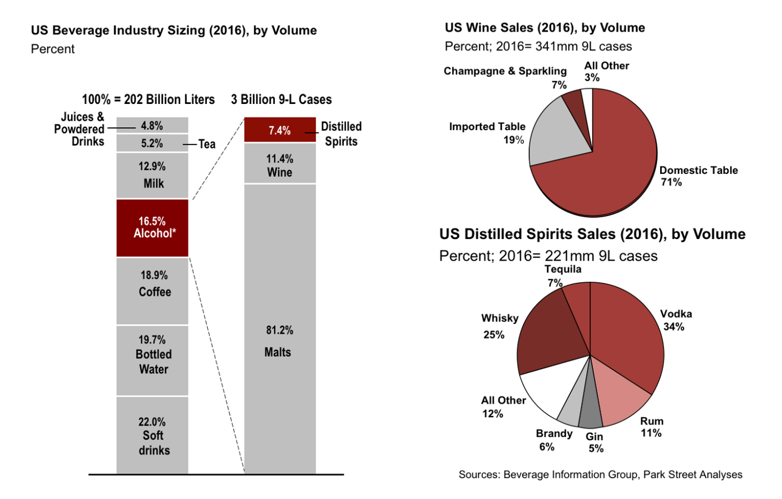
Beverage Information Group, Park Street Analyses in 2016: Liquor is the 4th most popular beverages in the states
Target Market
The Internal Revenue Service
If fraud is detected, then FBI should investigate more about the anomaly.

Slide 4
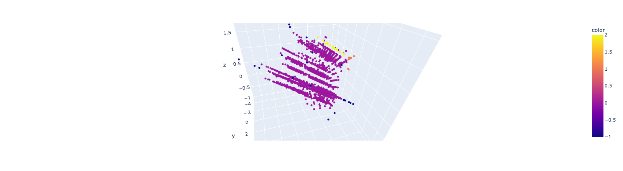
Clustering is divided into 3 cluster and 1 outliers

Slide 5
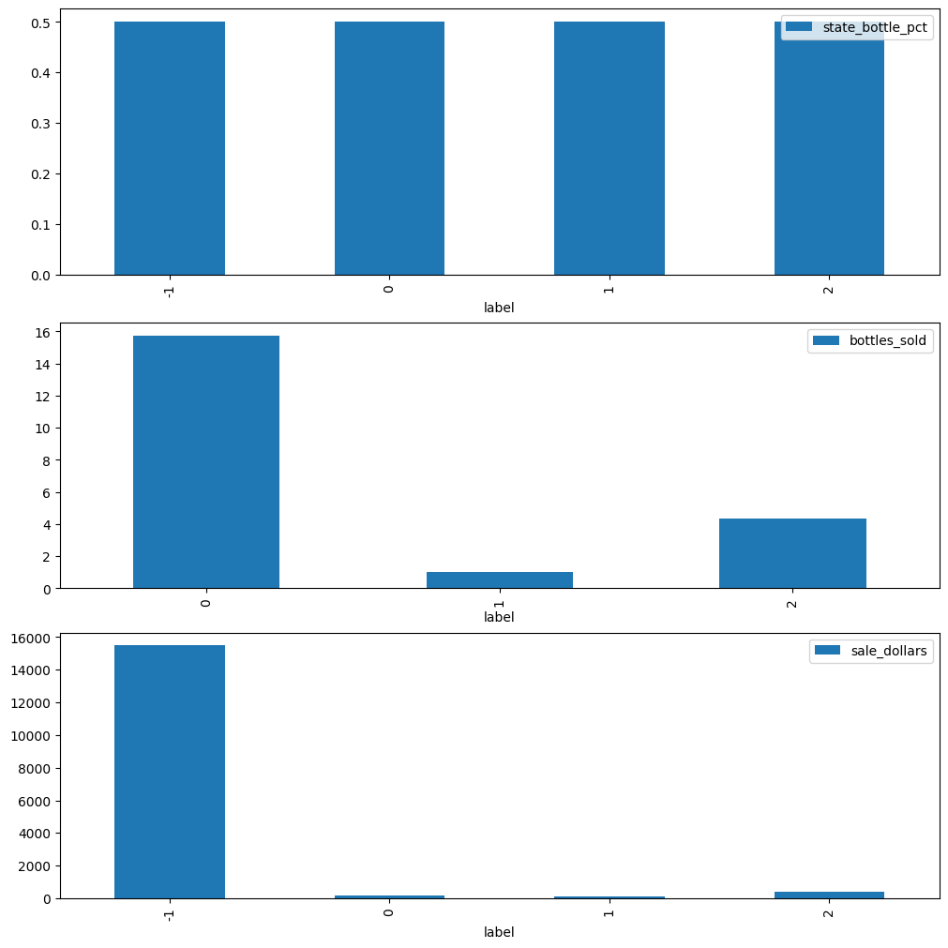
Conclusion: False reports and Money Laundering are happening
Profit Margin between clusters are the same
Outliers are indicated by Label -1
Label 0, 1, 2 only sell between 2 – 15,00 bottles on average per transaction.

